Slide 1
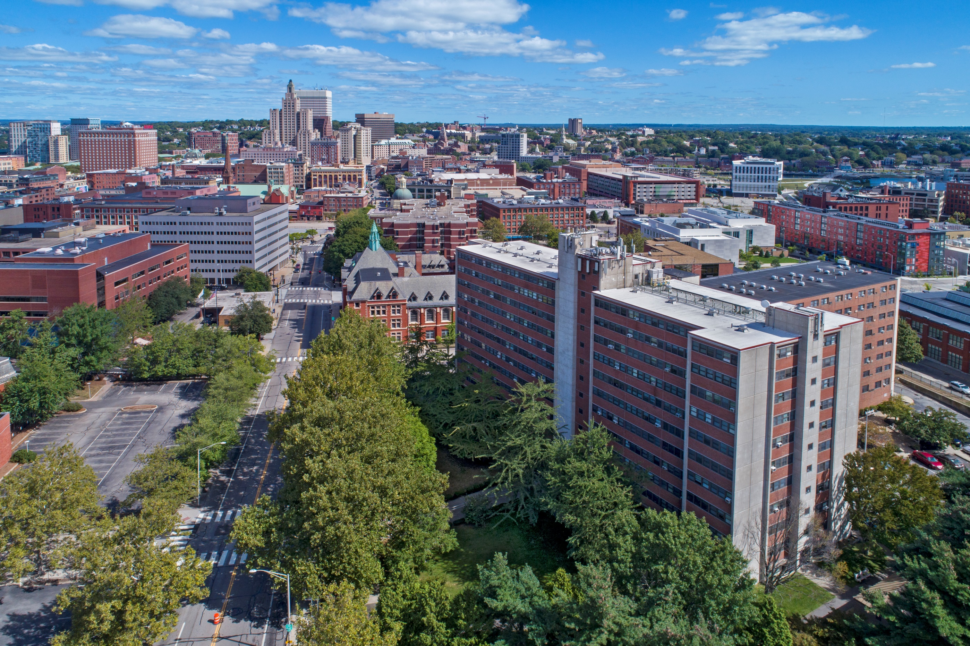
A partner in preserving & expanding deeply affordable housing
Presentation to the House of Representatives Special Legislative Commission to Study Housing Affordability
May 16, 2023
www.provhousing.org

Slide 2
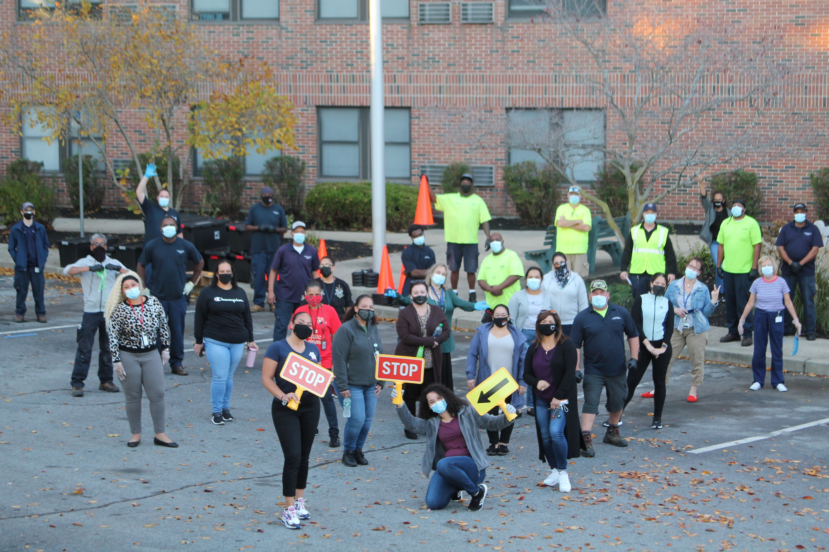
Overview
Who We Are
What We Do
Who We Serve and Our Impact
Challenges
Our Future Role in Solving the Crisis

Slide 3
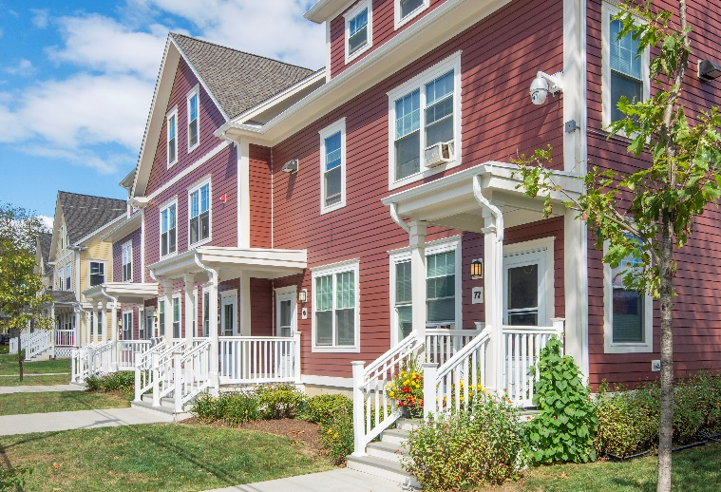
Who We Are
24 municipal PHAs across the state
RI Housing is voucher administrator for communities without voucher program
Nonprofits - Gateway and Kent Center have voucher only PHAs serving special populations
9,049 public housing units, 10,955 Section 8 vouchers
Primary source of funding is US Department of Housing and Urban Development (HUD)
Park Holm Apartments, Newport

Slide 4
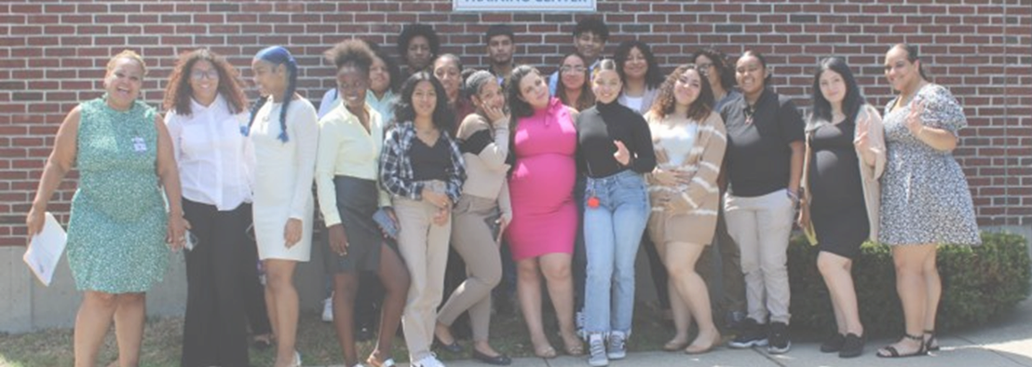
Who We Are - Governance
Established by individual cities and towns under state law
RIGL 45-25 - City Housing Authorities
RIGL 45-26 Town Housing Authorities
Most PHAs have five member boards appointed by municipal leaders
Cranston, East Providence, Newport, Pawtucket and Woonsocket have 7 members and Providence has 11 members
Resident Voice – boards have seats reserved for residents (2-3 seats per board)
State law also establishes Resident/Tenant Advisory Boards
HUD Requires PHAs to consult with Resident Advisory Boards on Annual Plans
Follow public procurement, open meetings, public record laws

Slide 5
What We Do
Public housing program – housing authorities own and operate apartments (with federal subsidy) for low-income families, elderly and disabled
Section 8 Rental Assistance programs – housing authorities administer voucher subsidies for very low and extremely low-income tenants in privately owned properties
Tenant based and project-based vouchers
Special Programs – Homeownership; Self Sufficiency Programs (education, workforce development); youth programs and health and wellness programs
Other Housing programs - Tax Credit; Other Affordable Housing; Shelter
Meatball Challenge, West Warwick Housing Authority

Slide 6
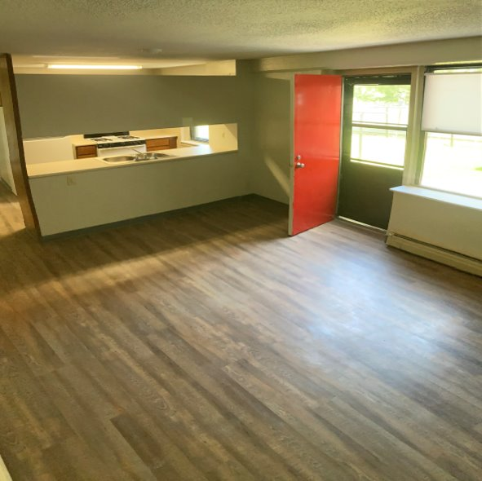
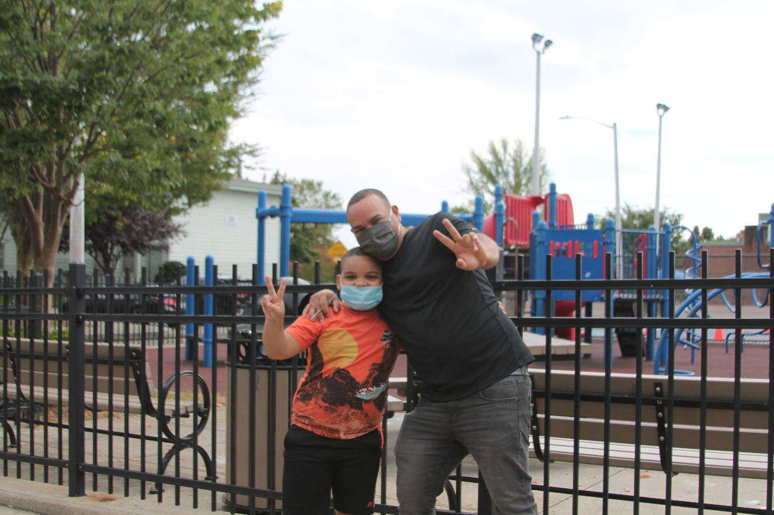
Programs
PUBLIC HOUSING
Residents pay 30% of their income toward rent and utilities, open to families at/below 80% AMI (but most below 50%)
HUD provides subsidy for the day-to-day operation of properties and limited capital funding for major repairs
9,049 Units Across the State, from Westerly to Woonsocket
PHAs are required to inspect all units each year
HUD evaluates and rates PHAs’ performance each year through the Public Housing Assessment System (PHAS).
www.provhousing.org
Gallego Court, Pawtucket

Slide 7
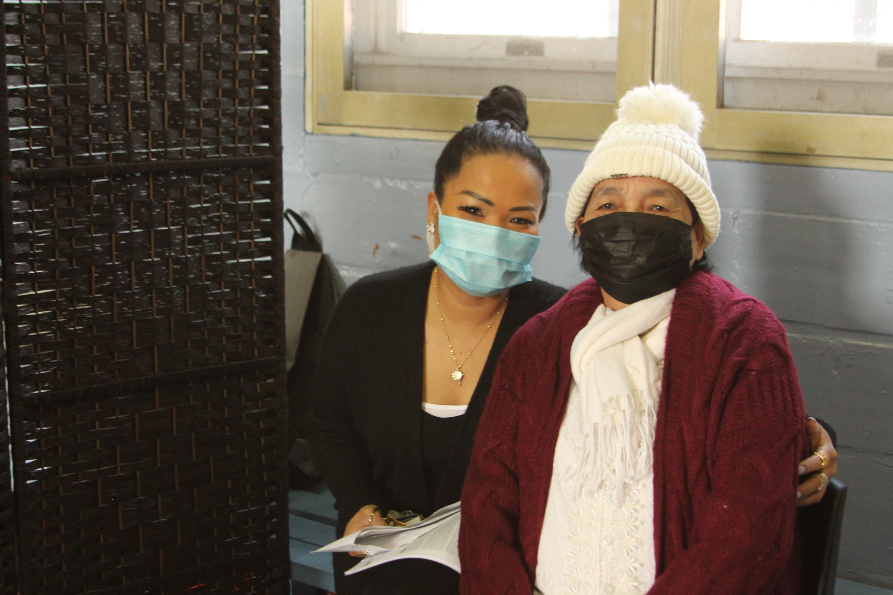
Housing Choice Voucher or Section 8 Program
Vouchers allow low-income individuals and families to lease units in the private rental market. Families pay 30% of income towards rent & utilities; income limit at admission is 50% of AMI; ¾ must be below 30% AMI.
Special program vouchers such as VASH, Mainstream/NED, Emergency Housing Vouchers
PHAs administer rental subsidies called Housing Assistance Payments (HAP) that are paid to landlords (average HAP payment $907/month)
PHAs inspect units every year or biannually
942 Project Based Vouchers (like tenant based, but they stay with the unit) contracted across the state

Slide 8
Special Programs – Vary By Agency
Family Self-Sufficiency – work with PH and S8 tenants on education, employment and financial goals. Increased rent payment goes towards escrow received at end of five-year program
ROSS – Service coordination for families (self-sufficiency) and elderly/disabled (aging in place)
Homeownership
HUD Homeownership Counseling
Section 32 – Public Housing Units
Section 8 – Voucher helps pay mortgage
Security – On site security, municipal collaborations
Other – Youth programs, broadband, food and meal programs, more

Slide 9
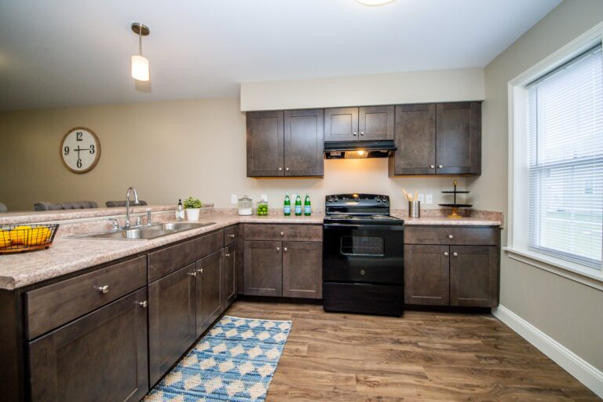
Beyond Traditional Public Housing Programs
Tax Credit Housing
Coventry
East Greenwich
Newport
Pawtucket
Smithfield
Project Based Section 8
East Greenwich
Newport
Pawtucket
Shelter and Transitional Housing
Newport
Pawtucket
Park Holm Apartments, Newport

Slide 10
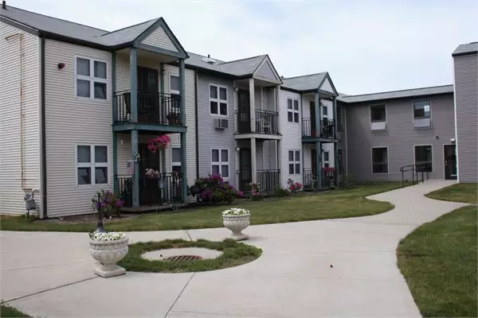
Our Impact
34,504 residents housed in Public Housing and Section 8 programs
Among the most vulnerable in state with average family income $18,475; 32% youth and 23% elderly
942 Project Based Voucher units supporting privately owned affordable housing
$88.9M in payments to landlords in 2022 to support Section 8 participants
PILOT payments to two dozen communities across the state
Burns Court in Pawtucket
Statewide data being gathered:
Employment by PHAs
Construction contracts
Utility payments

Slide 11
Our Public Housing Families
14,222 residents of public housing
23% of residents are under the age of 18
38% of residents are elderly
42% of households have a member with a disability
82% White, 13% Black; 1% Asian, 1% Native American, 2% Other
34% Hispanic (may be any race)
17% of all households are female headed households with children
23% of families have employment as a source of income
Average annual family income is $18,998
56% of families have incomes below 30% AMI

Slide 12
Our Section 8 Families
20,282 residents served
38% are under 18 years
13% of residents are elderly
45% of households have a member with a disability
Residents identify as 75% White; 19% Black; 2% Native American, 1% Asian, 3% other;
34% Hispanic (may be any race)
39% of all households are female headed households with children
36% of families have employment as a source of income
Average annual family income is $18,493
At least 75% of participants must have incomes below 30% AMI at admission

Slide 13
Main Challenges
Decades long waiting lists – 23,000+ on centralized waiting list
PHAs don’t have a “seat at the table” – but are providers of more than 20,000 housing units and subsidies in RI
Eviction vs. Mission: Seeking to preserve housing for those who need it but needing to evict at times for matters of safety or unpaid rent
Backlog of Capital Needs / Maintaining Properties with Insufficient Capital Funds
Rent Collection Post-COVID
HUD Oversight and Regulations
Mental and Behavioral Health Challenges and Limited Supportive Services

Slide 14
Evictions and Rent Collection
With Rent Relief RI, many PHAs worked closely with RI Housing to provide support for as many tenants as possible.
While majority of tenants do pay their rent, since pandemic programs have ended, some tenants have not returned to paying rent consistently
PHAs programs reduce tenant’s rent as soon as they are notified of income reductions
HUD scores PHAs through PHAS system in part based on rent collection
HUD now requires 30-day notice before taking tenants to court for nonpayment, as opposed to 14 day for private landlords in RI.
Behavioral evictions: PHAs must address behavior that jeopardizes public safety – PHAs & Judges cannot require tenants to access services

Slide 15
Public Housing Capital Needs
Nationally- $23,365 per unit capital needs backlog in 2011 ($26 Billion)
$3,155 per unit accrued additional needs each year
Public Housing Capital Need in Rhode Island would be $290 million in 2023 dollars
$39 million in increased additional needs annually in RI far exceeds annual capital funding of $26 million (average of just $1M per PHA)
Needs may be higher in RI than national average due to age of housing and high construction costs
PHAs required by HUD to have all contract work done at prevailing wage
Notes:
Note: This problem is not unique to RI, but as noted in last bullet it may be more acute here than some places.
Second bullet (assuming RI matched federal need and had no deterioration since 2011)
Third bullet takes $3155/yr, inflates for 2011-23 inflation, and multiplies by 9,049 units

Slide 16
Our Future Role in Solving Crisis
PHAs as providers of deeply affordable housing – this needs to be a bigger part of the state’s housing conversation.
PHAs are dynamic, talented and collaborative and are very unique landlords
We can and do develop new affordable housing
We have strong connections to our residents and are well positioned to model supportive housing and cross sector planning initiatives with health and education
PHAs need to preserve our 9,049 current public housing units to provide quality housing and dignity to the important population we serve
Through Project Based Vouchers, PHAs can self-develop support and partner with CDCs and private developers to produce and preserve affordable housing
PHAs are uniquely positioned to bring some new HUD resources to the State
Notes:
New resources – Emergency Housing Vouchers (159), Mainstream vouchers (hundreds of new since 2019), FYIs (five agencies so far), FUPs

Slide 17
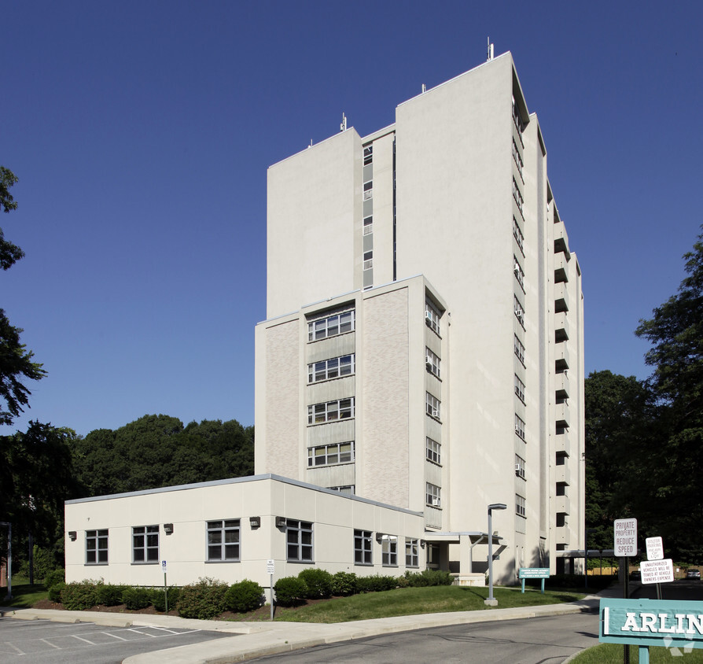
Deeply Affordable Housing
Whereas tax credit housing primarily serves families at 60-80% of AMI, and workforce housing above that, PHA’s are the predominant provider of housing that primarily serve families at the 30-50% AMI and below
Type of Affordable Housing | Income Levels Primarily Served | Incomes for a Family of 3
Public Housing Authorities | 0-50% AMI | $0-$44,300
Tax Credit* | 60-80% AMI | $53,160-$70,900
Workforce Housing | 80-120% AMI | $70,900-$106,120
Arlington Manor, Cranston
*Tax credit properties are required to serve very low income residents with public housing vouchers, but tax credit rents make these properties out of reach for those without vouchers

Slide 18
Thank You
Questions?

